Slide 1


Kancolle WIKI
Site: https://wikiwiki.jp/kancolle/

Slide 2
Case details
Supported by the community
Create
Update
Modify
Tech support
Powered by “Pukiwiki”

Slide 3
The theory
The Wisdom of Crowds (Guck et al. 2018)
Quality Through Coordination
Coordination between contributors instead of working independently
Kittur, Aniket, and Robert E. Kraut. "Harnessing the wisdom of crowds in wikipedia: quality through coordination." In Proceedings of the 2008 ACM conference on Computer supported cooperative work, pp. 37-46. ACM, 2008.

Slide 4
Pukiwiki
Software Written in PHP
Now Supports PHP 7.3
Looks like 90s
Limited User Experience

Slide 5
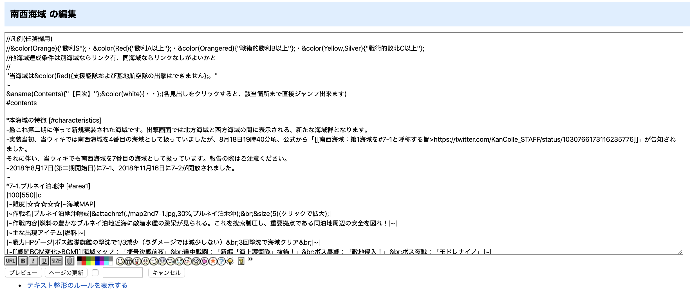
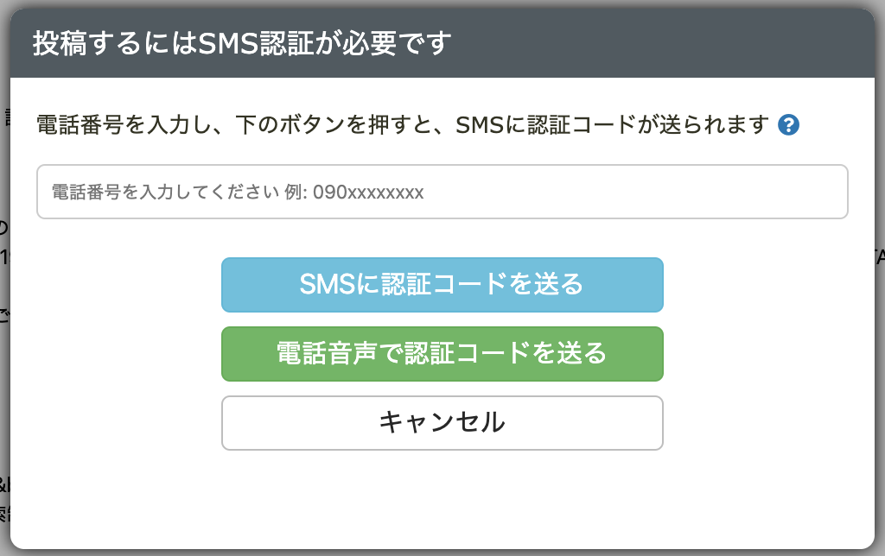
Limited Editing Experience

Slide 6
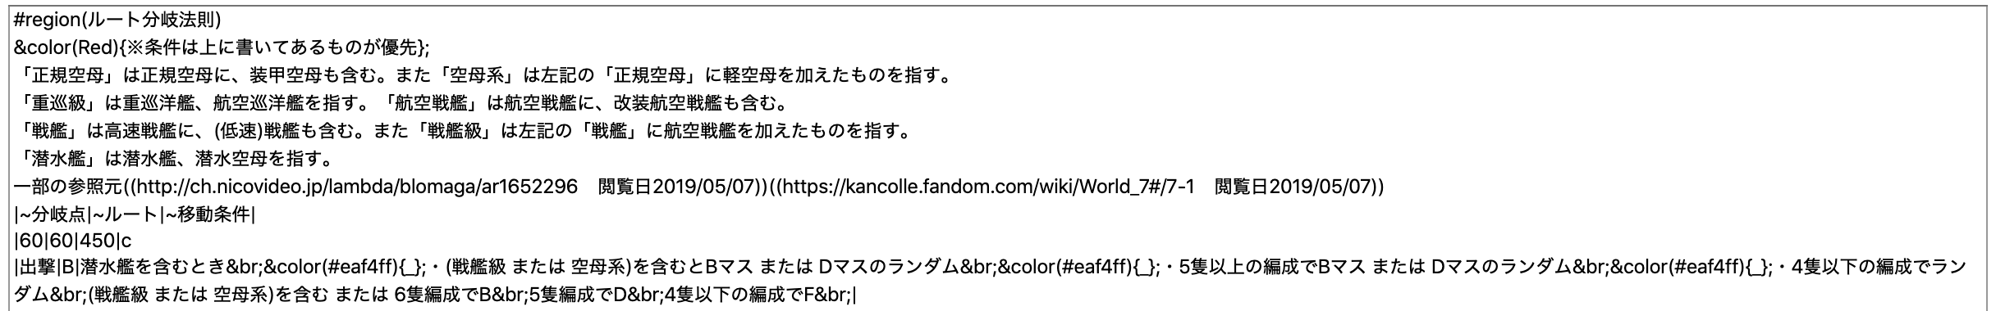
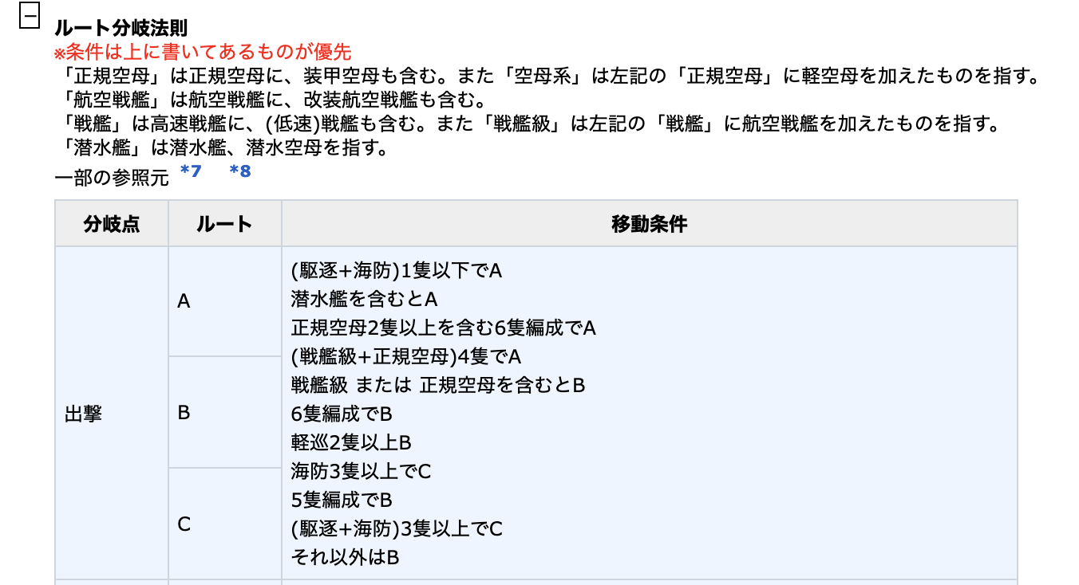
Editing Example

Slide 7
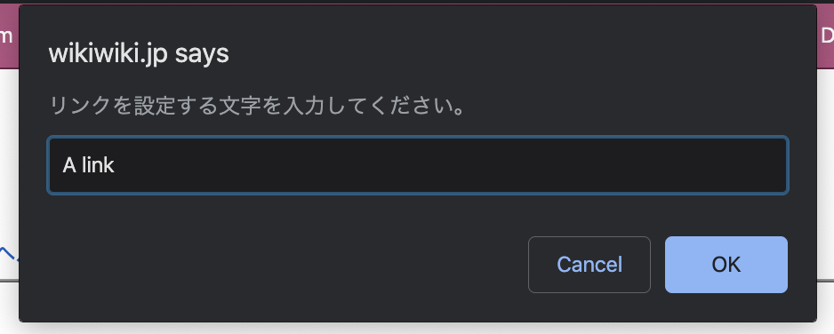
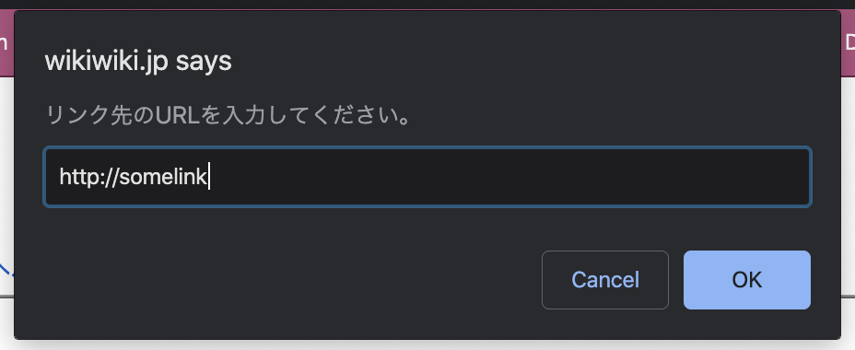
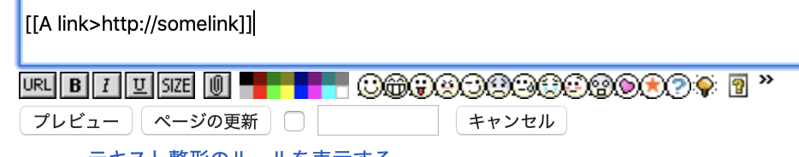
Editing Example

Slide 8
Alternatives

Slide 9
Alternatives
Long-term maintenance and support
FY 2018-2019 $93.1 Million Budget
Suitability for huge, highly active wikis
MediaWiki is used by the English Wikipedia, the largest wiki in the world. It has been designed with scalability in mind for high-usage, high-profile sites that are prone to vandalism, spam, and other attacks.
Exceptional interchangeability
Whatever sorts of articles or templates (e.g. infoboxes) seeing on Wikipedia that would be useful in other site, it can be imported.
Notes:
with more than 48 million pages, 800 million edits since the project's inception, and 470 million unique visitors monthly.
Often the starting place for a new wiki is to borrow content from Wikipedia (subject to the CC BY-SA license). If you use wiki software other than MediaWiki, the Wikipedia content might have to be reformatted or you might have to start from scratch

